Slide 1
Bone Dragon team
March 4th, 2015
Telerik Software Academy
C# Part 2 Team Work

Slide 2
Team Members
Daniel Filipov Daniel
Mirela Napetova mimirerelala
Ivaylo Arnaudov ivaylo.aranudov
Kristian Kamenov kristiqnKamenov
Silviya Nedelcheva silvi6666
Nikola Russev NikIvRu
Branimir Georgiev branimir.georgi
Nikolay Dimitrov oldboy [has not participated!]

Slide 3
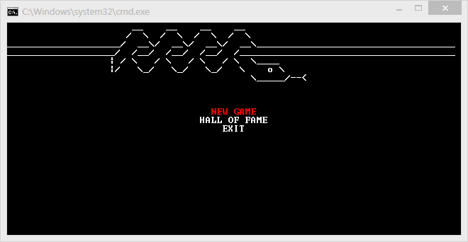
Game we chose: Snake

Slide 4
Time to play!

